Slide 1


Joseph Janadi
May 19, 2023

Slide 2

Outline
Executive Summary
Introduction
Methodology
Results
Conclusion
Appendix

Slide 3
Executive Summary
In this study, we analyzed SpaceX rocket launch data to predict the landing outcome of the first stage. The data was retrieved from using the SpaceX REST API and by web scraping a Wikipedia page. Then, only the relevant feature were retained and the landing outcome was converted to a integer data type (0 or 1) so that the data could be more easily analyzed. Exploratory data analysis was performed by visualizing the data in the form of tables, charts, graphs, and maps, using SQL, matplotlib, seaborn, Folium, and Dash with Plotly. Finally, four classification models were built in order to most accurately predict whether a launch would have a successful landing outcome.
The analysis revealed that rockets that launch from KSC LC-39A with a payload mass between approximately 2,000 and 4,000 kg into SSO, HEO, GEO, or ES-L1 have the greatest chances of landing successfully.

Slide 4
Introduction
Rocket launches average approximately $165 million for most companies. However, SpaceX has been able to lower costs to about $62 million by reusing the first stage after each launch. If historical launch data can be used to predict whether SpaceX's first stage will land successfully, another company can determine whether or not to bid against SpaceX for a rocket launch.

Slide 5

Section 1

Slide 6
Methodology
Executive Summary
Data collection methodology:
Describe how data was collected
Perform data wrangling
Describe how data was processed
Perform exploratory data analysis (EDA) using visualization and SQL
Perform interactive visual analytics using Folium and Plotly Dash
Perform predictive analysis using classification models
How to build, tune, evaluate classification models

Slide 7
Data Collection
SpaceX's historical launch data was retrieved from two different sources: a SpaceX API and Wikipedia's webpage titled "List of Falcon 9 and Falcon Heavy launches". Using the API, past launch data was retrieved from the /launches/past page, and then data in that table was used to retrieve additional information about each launch from other pages. Next, a request was made to the Wikipedia webpage and additional data was extracted from the third table via web scraping.

Slide 8
Data Collection – SpaceX API
requests.get("https://api.spacexdata.com/v4/launches/past")
requests.get("https://api.spacexdata.com/v4/rockets/"+str(x)).json()
requests.get("https://api.spacexdata.com/v4/launchpads/"+str(x)).json()
requests.get("https://api.spacexdata.com/v4/payloads/"+load).json()
requests.get("https://api.spacexdata.com/v4/cores/"+core['core']).json()
GitHub URL: REST API

Slide 9
Data Collection - Scraping
GitHub URL: Web Scraping
response = requests.get("https://en.wikipedia.org/w/index.php?title=List_of_Falcon_9_and_Falcon_Heavy_launches&oldid=1027686922")
soup = BeautifulSoup(response.content)
html_tables = soup.find_all('table')
first_launch_table = html_tables[2]
first_launch_table.find_all('th')
for table_number,table in enumerate(soup.find_all('table',"wikitable plainrowheaders collapsible")):
for rows in table.find_all("tr"):
row=rows.find_all('td')

Slide 10
Data Wrangling
We are interested in identifying the relationship between each feature of a rocket launch and whether the landing was successful or not. First, we created a new column called "Class" of data type "int" that indicates whether each launch had a successful landing (value "1") or unsuccessful (value "0"). This allowed us to easily visualize the relationship between "Class" and various features, including "LaunchSite", "PayloadMass", and "Orbit".
GitHub URL: Data Wrangling

Slide 11
EDA with Data Visualization
We chose to visualize the relationship between landing outcome ("Class") and four features: "PayloadMass", "LaunchSite", "Orbit", and launch year. This allowed us to quickly and easily identify which launch sites and orbits had the highest and lowest success rates and how the payload mass factored into those rates. We were also able to determine that the success rate steadily increased over the years.
GitHub URL: Data Visualization

Slide 12
EDA with SQL
Displayed unique launch sites
Displayed 5 records where launch site begins with "CCA"
Displayed total payload mass of boosters launched by NASA
Displayed average payload mass carried by booster "F9 v1.1"
Displayed date of first successful landing outcome on a ground pad
Displayed the names of the boosters that had payload mass between 4000 and 6000 kg and landed successfully on a drone ship.
Displayed total number of successful and failed mission outcomes
Displayed booster versions that have carried the maximum payload mass
Displayed month, landing outcome, booster version, and launch site of each launch in the year 2015.
GitHub URL: SQL

Slide 13
Build an Interactive Map with Folium
Folium was used to visualize launch site locations, the number of successful and failed landings at each site, and distances to local geographical features. Red circles were placed at each launch site location. Then, marker clusters were placed at each launch site location, containing markers that were either green to indicate a successful landing or red to indicate a failed landing. This helped to visualize the relative frequency of successful landings at each site. Finally, we added lines that connected a particular launch site to local geographical markers, such as the nearest point on the coast line, the nearest railroad, and the nearest city. This revealed which geographical features are most closely associated with launch site locations and which.
GitHub URL: Folium

Slide 14
Build a Dashboard with Plotly Dash
Using Dash and Plotly, we created an interactive dashboard to allow for easy visualization of selected features. We created two figures. The first figure is a pie chart that has the option to display the percentage of total successes that each launch site had, or to display the percentage of successes and failures of each individual launch site. This allows the user to quickly determine which launch site had the greatest number of successes as well as the greatest success rate. The second figure is a 'class' vs. 'Payload Mass (kg)' scatter plot with the color of the points corresponding to the booster version. This allows the user to identify the relationship between payload mass, booster version, and landing outcome.
GitHub URL: Plotly Dash

Slide 15
Predictive Analysis (Classification)
First, the features were transformed, using sklearn.preprocessing.StandardScaler. Then, the data was split into a training and testing set, using sklearn.model_selection.train_test_split. Lastly, the data was trained on four different classification models: logistic regression, support vector machine, decision tree, and k-nearest neighbors. Grid search cross validation was performed on the data to determine the best hyperparameters for each classification model. The data was tested on the testing set and a confusion matrix was constructed to determine which classification model performed the best.
GitHub URL: ML Classification

Slide 16

Section 2

Slide 17
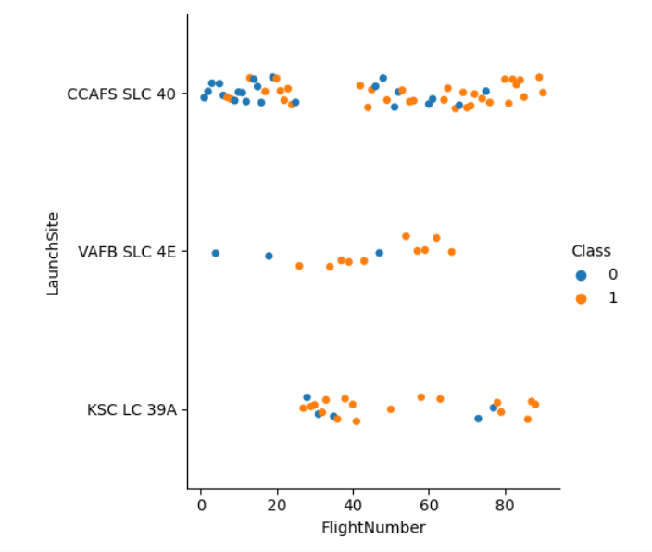
Flight Number vs. Launch Site
The scatter plot at right represents every launch as a point, categorized by launch site. Each point is colored blue or orange, indicating whether the landing was a failure or a success, respectively.
Most launches took place at CCAFS SLC 40.

Slide 18
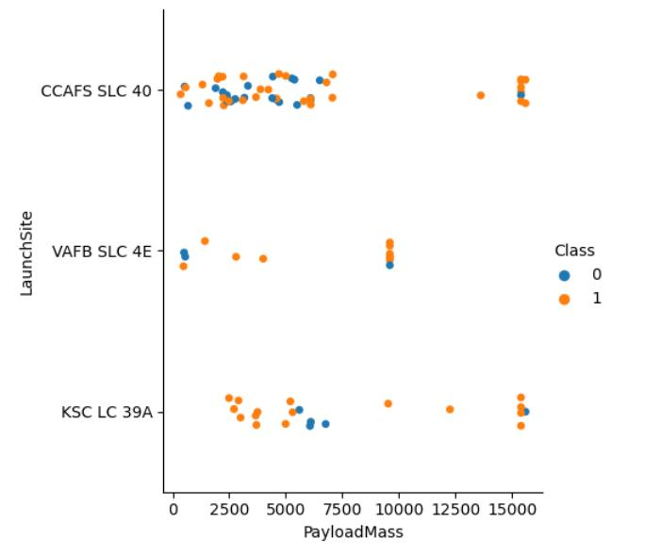
Payload vs. Launch Site
One can identify patterns in the relationship between payload mass, launch, site, and landing outcome.
At VAFB, no rockets with a payload mass greater than 10,000 kg were launched.

Slide 19
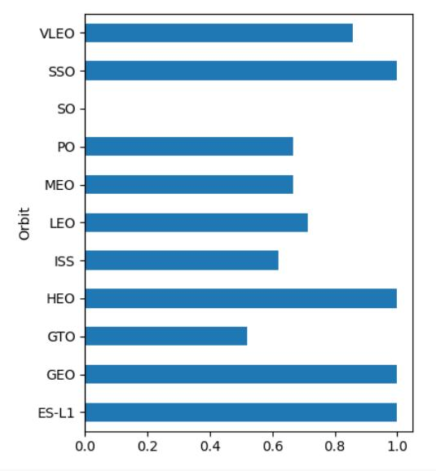
Success Rate vs. Orbit Type
The orbit types with a 100% landing success rate are SSO, HEO, GEO, and ES-L1.
Most of the other orbit types average and approximately 60% landing success rate, the lowest being SO with 0% and GTO with about 50%.

Slide 20
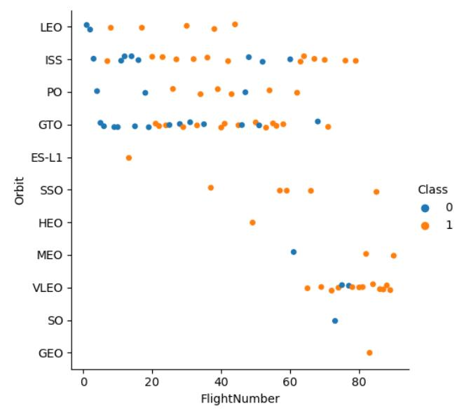
Flight Number vs. Orbit Type
The orbit types with the greatest number of launches appear to be ISS and GTO. The orbit types with the least number of launches are ES-L1, HEO, SO, and GEO, each having only a single launch.
There appears to be a slight trend in flight number and the success of the landings, the clearest being in the case of LEO orbits.

Slide 21
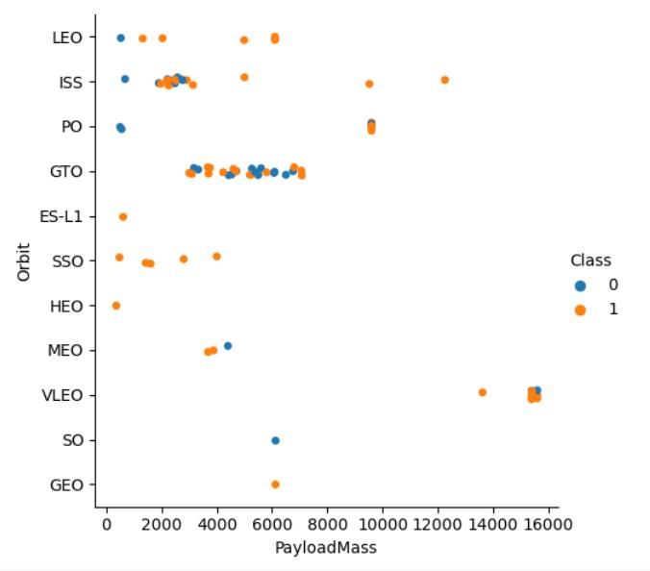
Payload vs. Orbit Type
There are some fairly strong associations between payload mass and orbit type. The vast majority of the launches have a payload mass of less than 8,000 kg. The only orbit types to have payload masses greater than 8,000 kg are ISS, PO, and VLEO.
VLEO launches have the greatest payload masses of all orbit types, each launch with a mass greater than 13,000 kg.

Slide 22
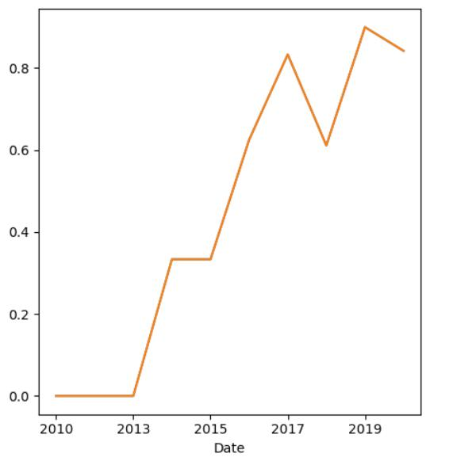
Launch Success Yearly Trend
The line graph at right indicates a clear, sharp upward trend in landing success rate as the years progress. This reveals marked improvement over time.

Slide 23
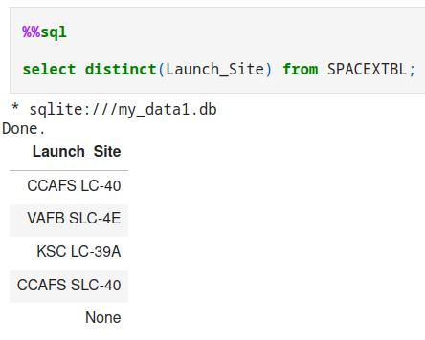
All Launch Site Names
There are four unique launch sites named as follows: CCAFS LC-40, VAFB SLC-4E, KSC LC-39A, CCAFS SLC-40.

Slide 24
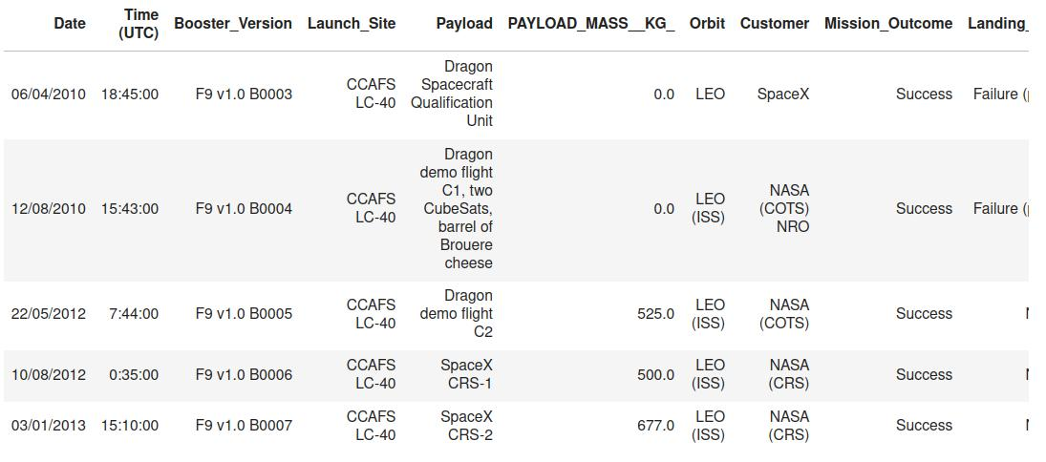
Launch Site Names Begin with 'CCA'
Five records of launches with launch sites that begin with 'CCA' are displayed at right.

Slide 25
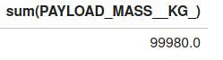
Total Payload Mass
The figure below is the sum of the payload masses of rockets that NASA launched in the time period covered by the data.

Slide 26
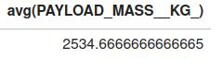
Average Payload Mass by F9 v1.1
The figure below is the average payload mass of rockets that had booster version F9 v1.1.

Slide 27
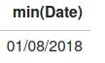
First Successful Ground Landing Date
The figure below is the date of the first successful landing on a ground pad.

Slide 28
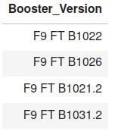
Successful Drone Ship Landing with Payload between 4000 and 6000
At right is the list of booster versions of rockets that had a payload mass between 4,000 and 6,000 kg and landed successfully.

Slide 29
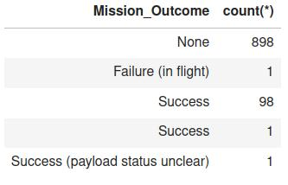
Total Number of Successful and Failure Mission Outcomes
The figure at right lists the total number of launches grouped by mission outcome.

Slide 30
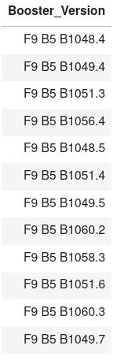
Boosters Carried Maximum Payload
At right is the list of booster versions that had the maximum payload.

Slide 31
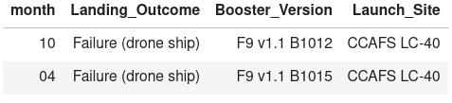
2015 Launch Records
Below is a list of the launches that failed to land on drone ships in year 2015

Slide 32
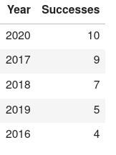
Rank Landing Outcomes Between 2010-06-04 and 2017-03-20
At right is the list of successful landing outcomes grouped by year and ordered from greatest to least.

Slide 33

Section 3

Slide 34
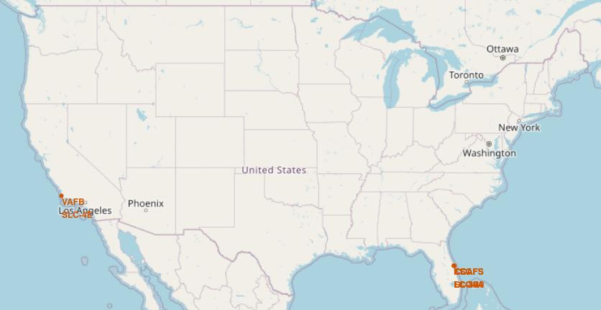
Map of Launch Site Locations
Above is a map of the five different locations from which SpaceX rockets were launched.
There are two groups of launch sites, one in southern California and the other in Florida, both of which are in close proximity to the ocean.

Slide 35
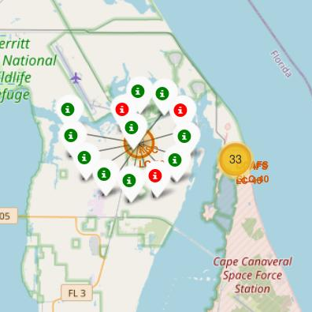
Map of Landing Outcomes by Site
At right is a map showing the launches in Florida, clustered by launch site. Each launch is colored either green or red to represent a successful or failed outcome, respectively.
KSC LC-39A had 10 successful landings and three failed.

Slide 36
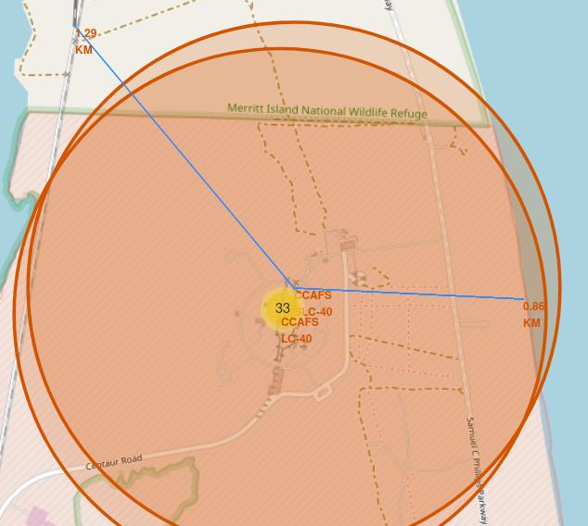
CCAFS Proximities
The map at right shows the distance from CCAFS launch sites to the nearest coast and the nearest railway. The nearest coast is 0.86 km away and the nearest railway is 1.29 km away.
This is an indication of the importance of a railway and ocean coast to launch sites.

Slide 37

Section 4

Slide 38
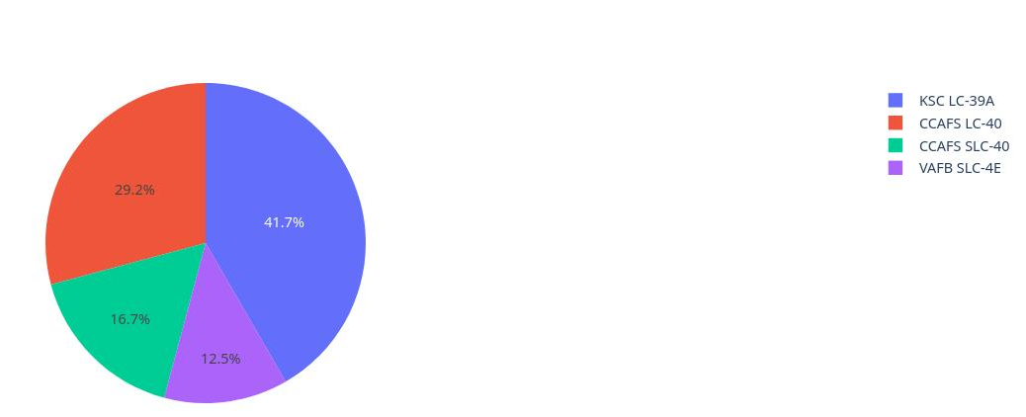
Percentage of Successes by Site
Below is a pie chart showing the percentage of total landing successes achieved at each launch site.
The site with the greatest number of successes is KSC LC39A, making up 41.7% of the total.

Slide 39
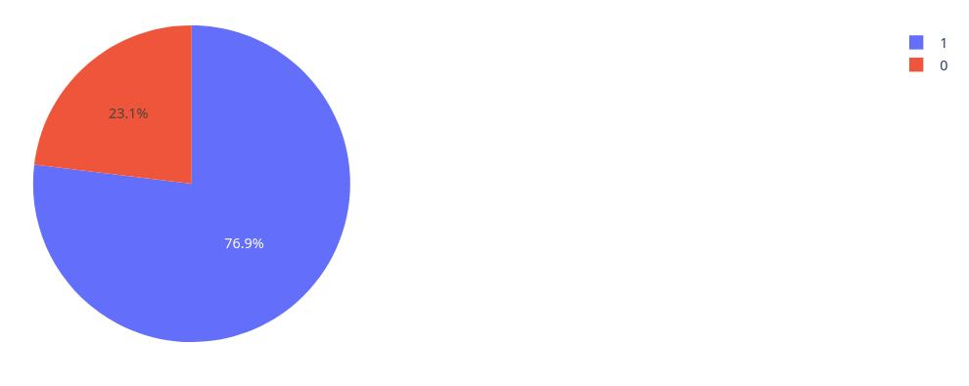
Success Ratio at KSC LC-39A
The pie chart at right shows the landing success ratio at the site KSC LC-39A.

Slide 40
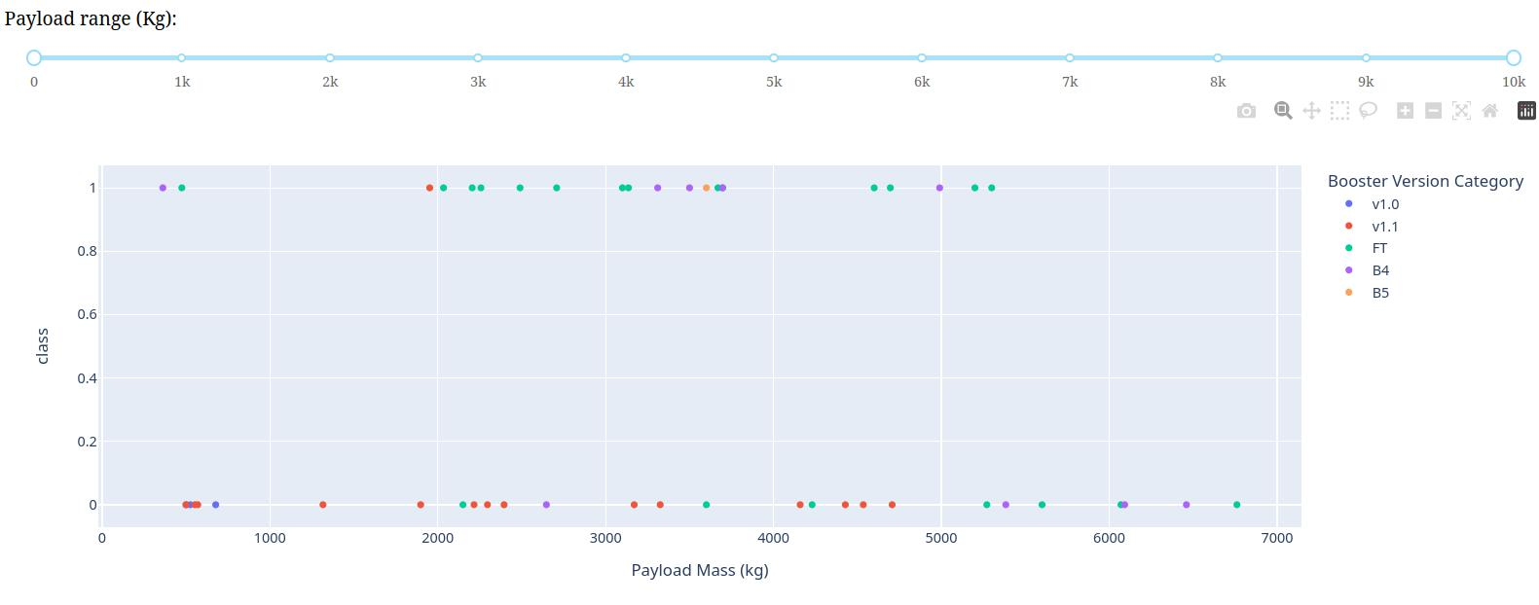
Payload Mass vs. Class Scatter Plot
Below is a scatter plot of landing outcome vs. payload mass. Each point represents a launch and its color indicates which booster version was used.

Slide 41
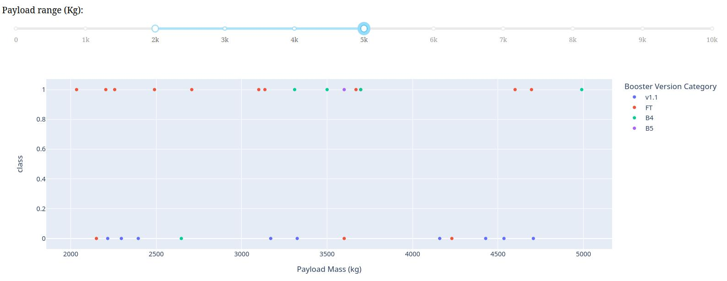
Payload Mass vs. Class Scatter Plot – Ideal Range
The highest success rate lies in the range of 2,000 kg to 5,000 kg, as indicated below.

Slide 42

Section 5

Slide 43
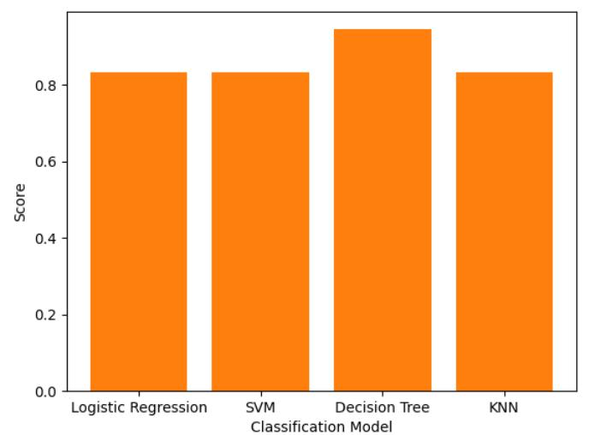
Classification Accuracy
All of the classification models performed similarly well.
However, the model with the greatest accuracy score is the Decision Tree.

Slide 44
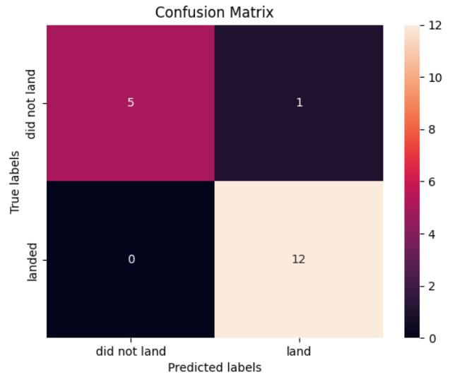
Confusion Matrix
The figure at right is the confusion matrix for the best performing model, the decision tree. The model accurately predicted every landing outcome except for one. It wrongly classified a failed landing as successful.

Slide 45
Conclusions
After conducting our analysis we found that the launch features most correlated with landing outcome are as follows: launch site, orbit, type, and payload mass.
The launch site that had the greatest success ratio was KSC LC-39A, with 76.9% of its launches landing successfully.
Several orbit types had a 100% success rate. These are SSO, HEO, GEO, and ES-L1. GTO had the second worst success rate of approximately 50%.
The payload mass range with the greatest success rate is approximately 2,000 kg to 4,000 kg.

Slide 46


